Slide 1
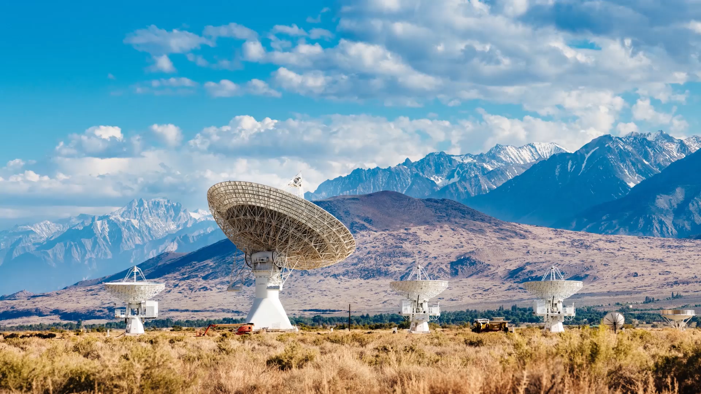
AI Patch Antenna Design
University of Arizona
Office of Dr. Xin
Support of Dr. Liu

Slide 2
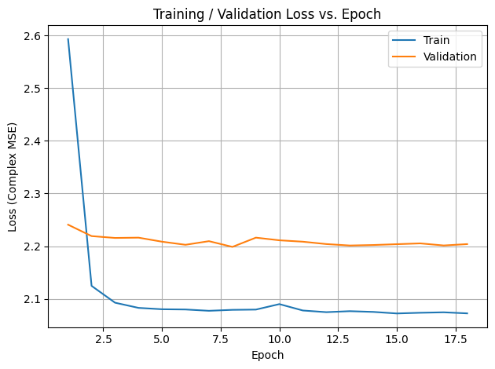
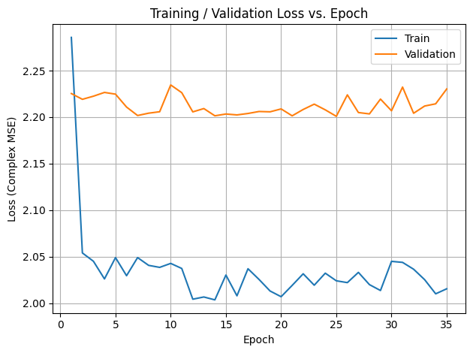
dmodel and ffn_hidden
dmodel = 128
ffn_hidden = 256
Best validation loss: 2.198567876863719 (Epoch Max 018)
dmodel = 64
ffn_hidden = 128 (Effective on Training)
Best validation loss: 2.200876880530736 (Epoch Max 035)

Slide 3
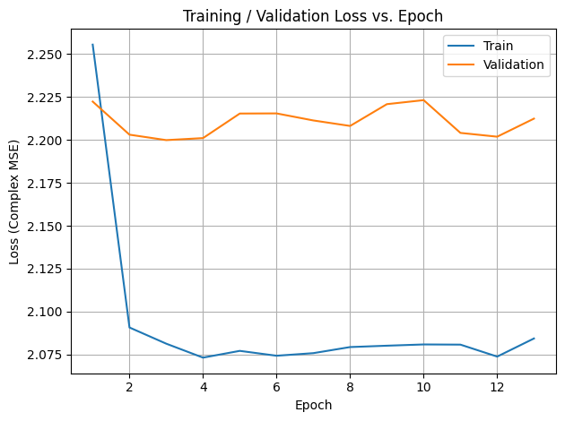
Num _ trasformer_ layers
dmodel = 128
ffn_hidden = 256
Num_transformer_layers = 2
Best validation loss: 2.198567876863719 (Epoch Max 018)
dmodel = 128
ffn_hidden = 256
Num_transformer_layers = 1
Best validation loss: 2.199937058453584 (Epoch Max 013)

Slide 4
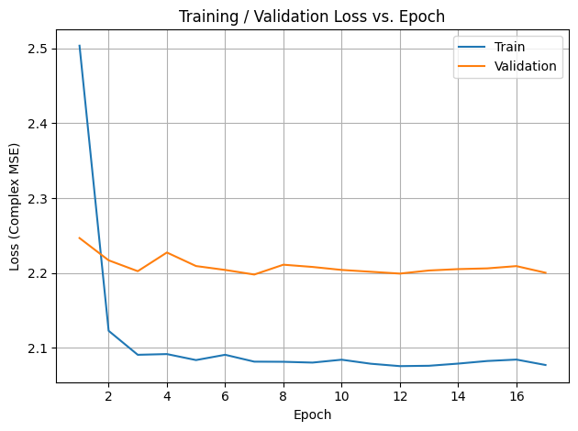
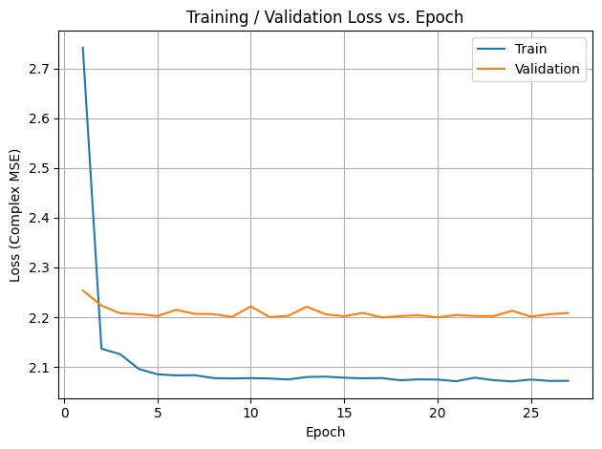
Dropout and Weight Decay
dropout = 0.1
Weight_decay= 1e-4
Best validation loss: 2.199623294811153 (Epoch Max 027)
dropout = 0.3
Weight_decay= 1e-5
Best validation loss: 2.1997353084123312 (Epoch Max 032)

Slide 5
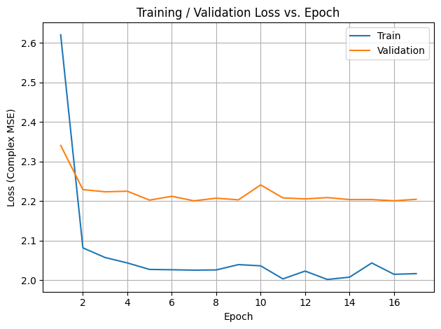
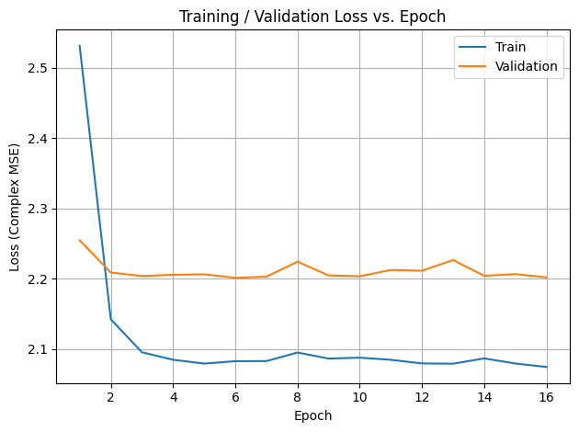
Augmentation on X Data
R1-6 Augmentation on Y data
R1-7 (Augmentation on X data only)

Slide 6
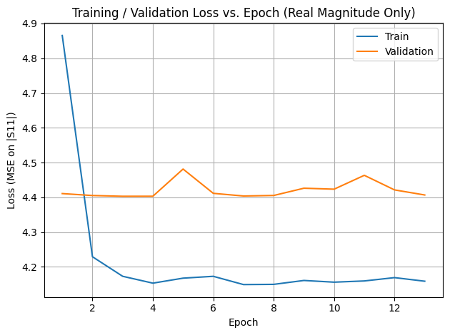
Real Value, Magnitude Only
R1-7 (Augmentation on X data only)
R1-8 (Augmentation on X data only and Magnitude only)

Slide 7
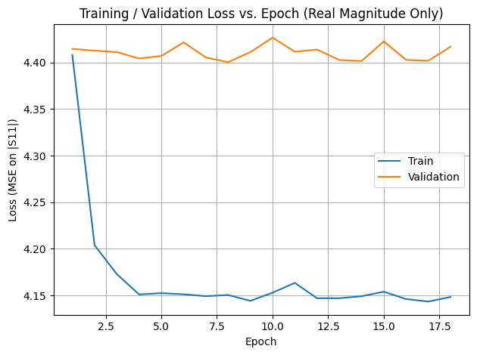
Shrink Model
R1-8 (Augmentation on X data only and Magnitude only)
R1-8 (Augmentation on X data only)
Shrink the model a lot and see if val responds:
dmodel = 32 hidden_dims = (16, 32) ffn_hidden = 64 num_spectral_blocks = 1 num_transformer_layers = 1 top_k_freq = 8

Slide 8
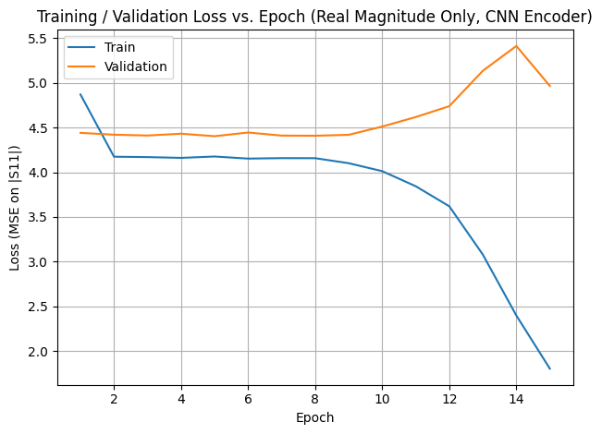
CNN vs GNN
R1-8 (Augmentation on X data only and Magnitude only)
R1-9 (Augmentation on X data, Mag only) and CNN encoder (Conv2d + Flatten + Linear)

Slide 9
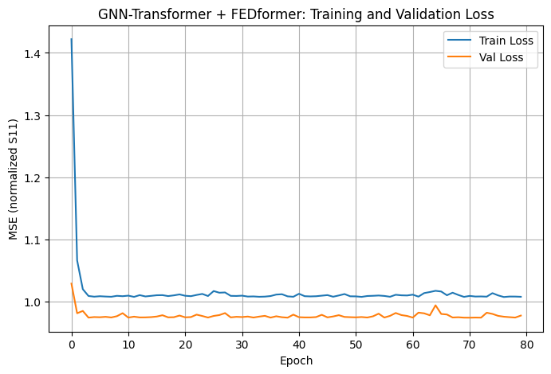
R_2-1
New Code with out Augmentation
Toke 20 min to train.

Slide 10
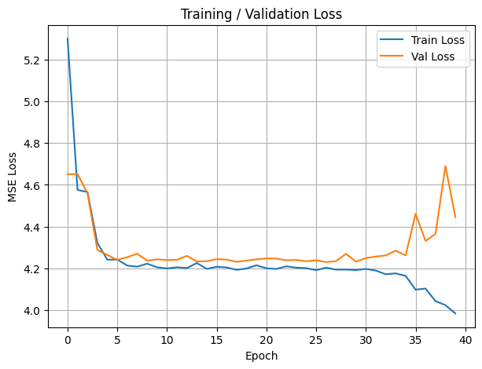
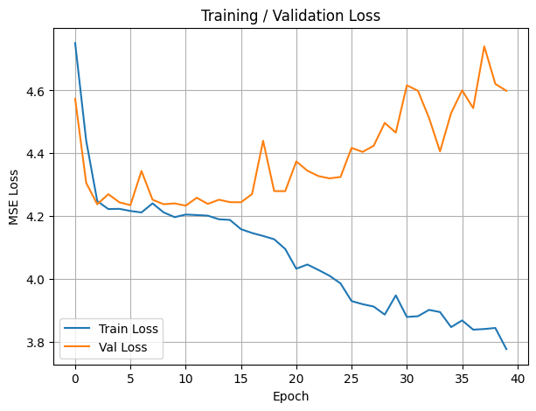
GPT R3-1
batch_size=32,
num_epochs=40,
learning_rate=0.001,
weight_decay=0.0001,
d_model=128,
cnn_channels=[32, 64, 128],
num_decoder_layers=4,
n_heads=8,
dropout=0.1,
fourier_modes=16
batch_size=32,
num_epochs=40,
learning_rate=0.001,
weight_decay=0.0001,
d_model=64,
cnn_channels=[32, 64, 128],
num_decoder_layers=1,
n_heads=8,
dropout=0.1,
fourier_modes=16

Slide 11
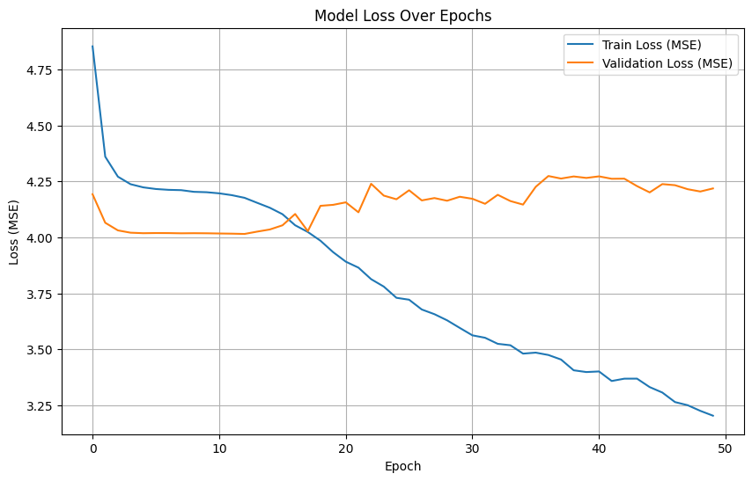
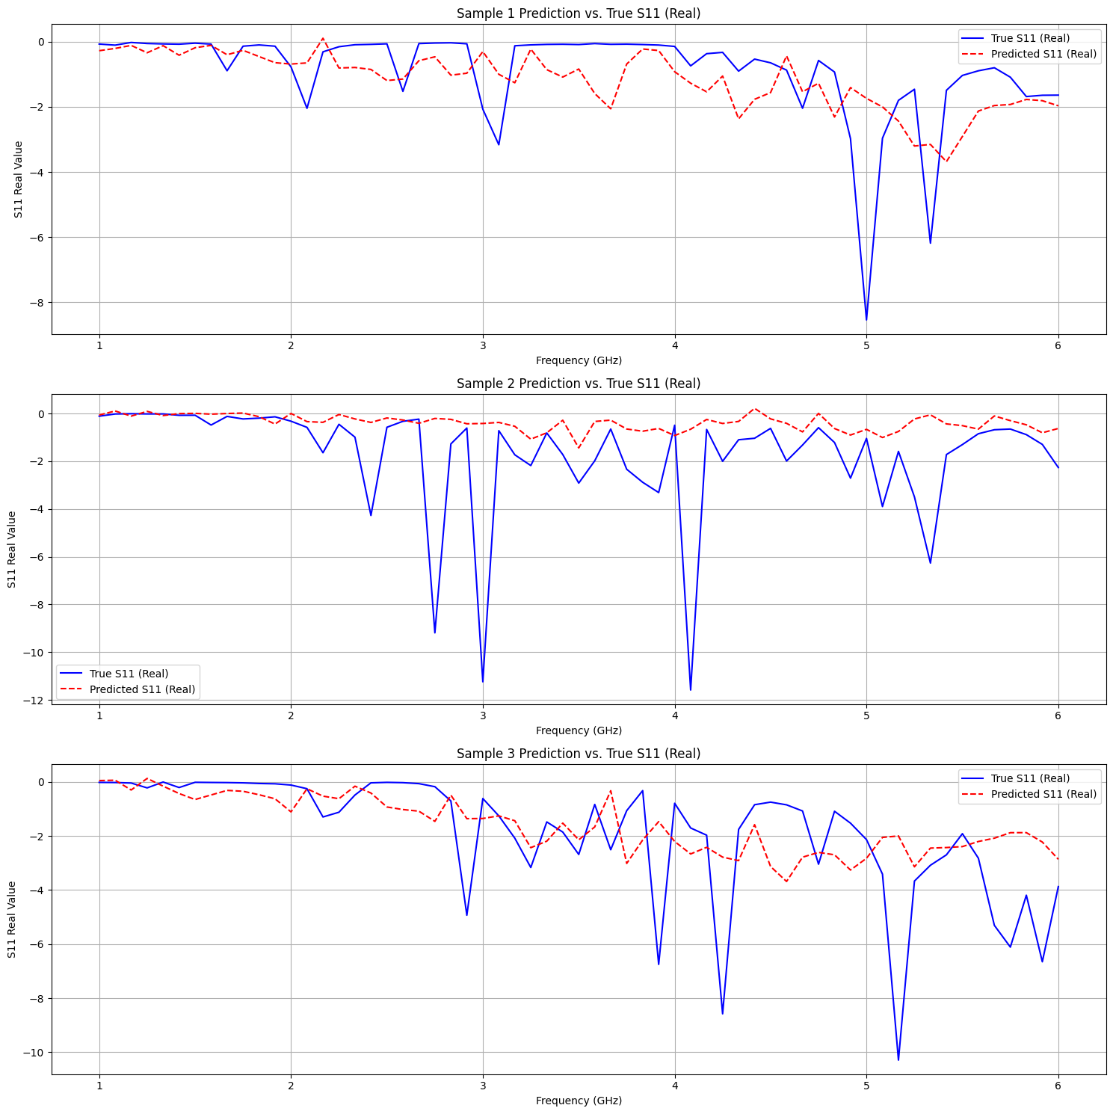
Gemini R1-0
# Data splitting and training parameters
TEST_SPLIT_RATIO = 0.2
RANDOM_SEED = 42
BATCH_SIZE = 32
EPOCHS = 50
LEARNING_RATE = 1e-4
# Augmentation and Noise parameters
APPLY_AUGMENTATION = True
APPLY_NOISE = True
NOISE_LEVEL = 0.05 # Std deviation for Gaussian noise
AUGMENTATION_FLIPS = True
AUGMENTATION_ROTATIONS = True
# CNN Encoder parameters
ENC_FILTERS = [16, 32, 64]
ENC_KERNEL_SIZE = (3, 3)
# FEDformer Decoder parameters
# Simplified parameters for the attention block
D_MODEL = 64 # Dimension of the model (feature size)
N_HEADS = 8 # Number of attention heads
DROPOUT_RATE = 0.1
N_LAYERS = 2 # Number of encoder/decoder layers

Slide 12
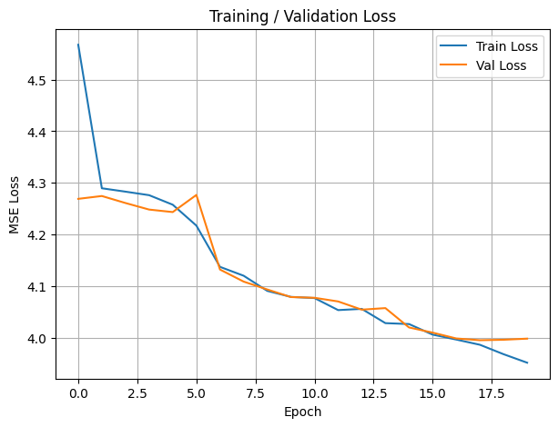
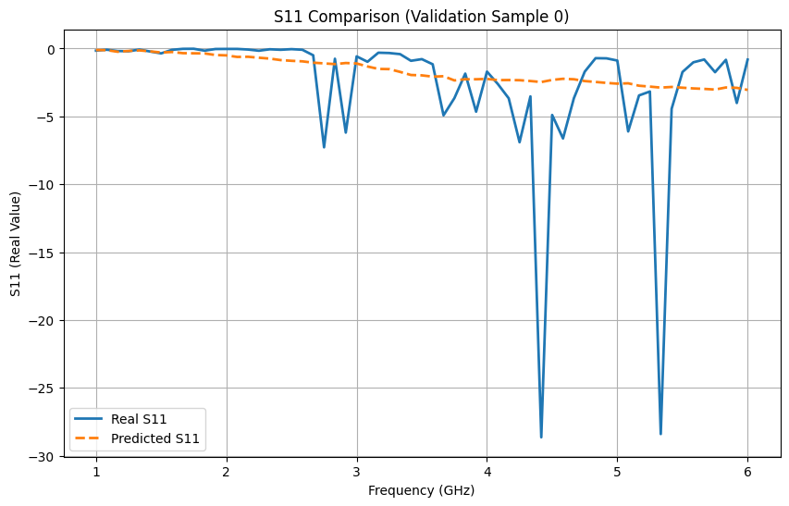
ChatGPT R3-3
Tiny CNN model (5k-50k params)

Slide 13
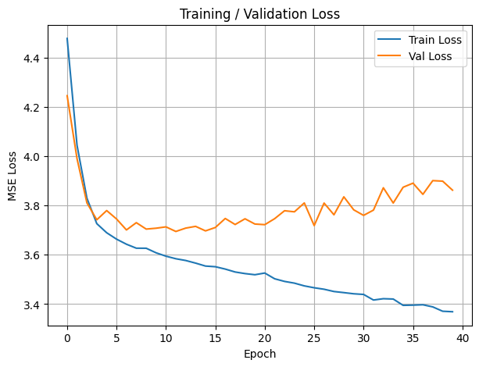
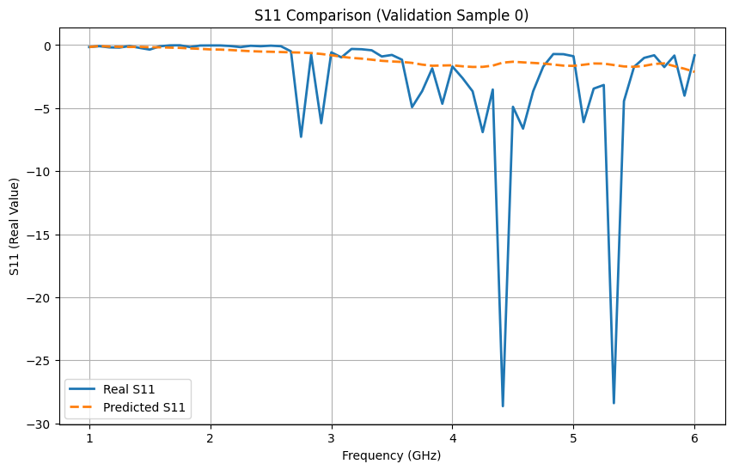
ChatGPT R3-4
Random Forest / ExtraTrees baseline

Slide 14
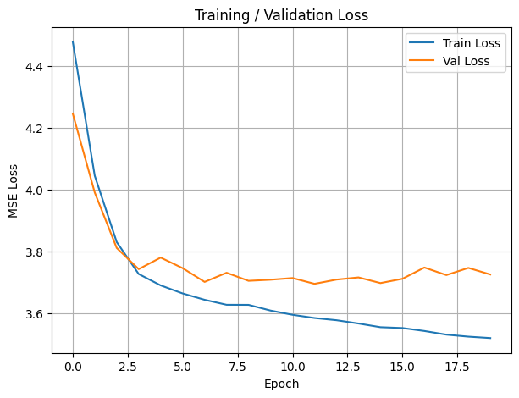
ChatGPT R3-5
Resonance-weighted loss (prioritize regions below threshold)

Slide 15
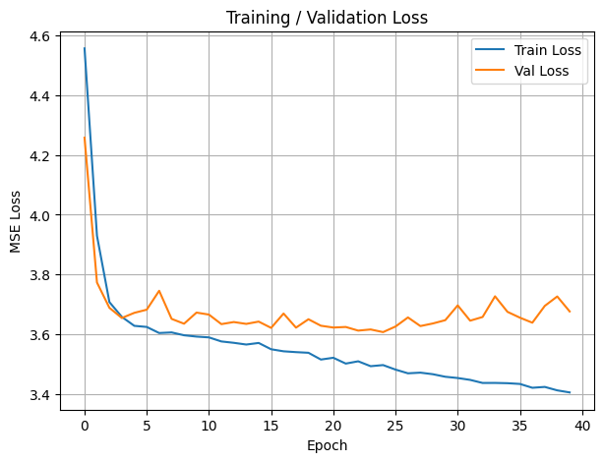
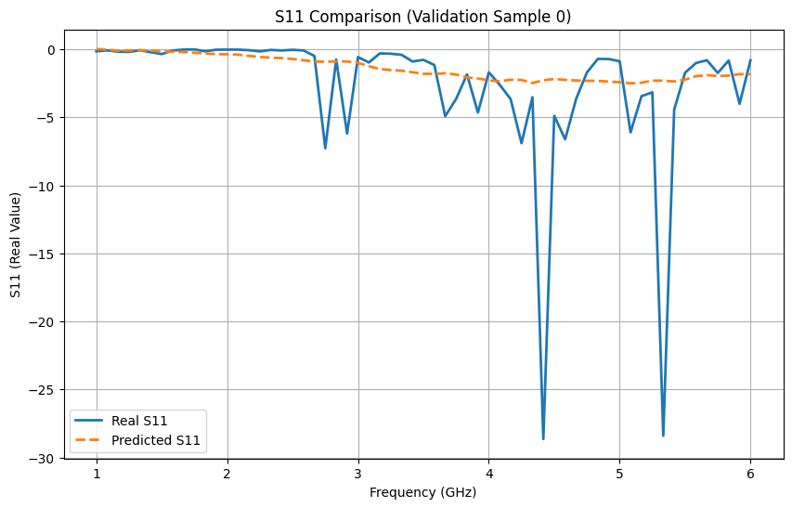
ChatGPT R3-6
Add 2D positional information (row/col coordinates) to your existing CNN encoder cleanly by concatenating two extra coordinate channels to the 1×10×10 geometry input. x: (B, 1, 10, 10)

